Slide 1
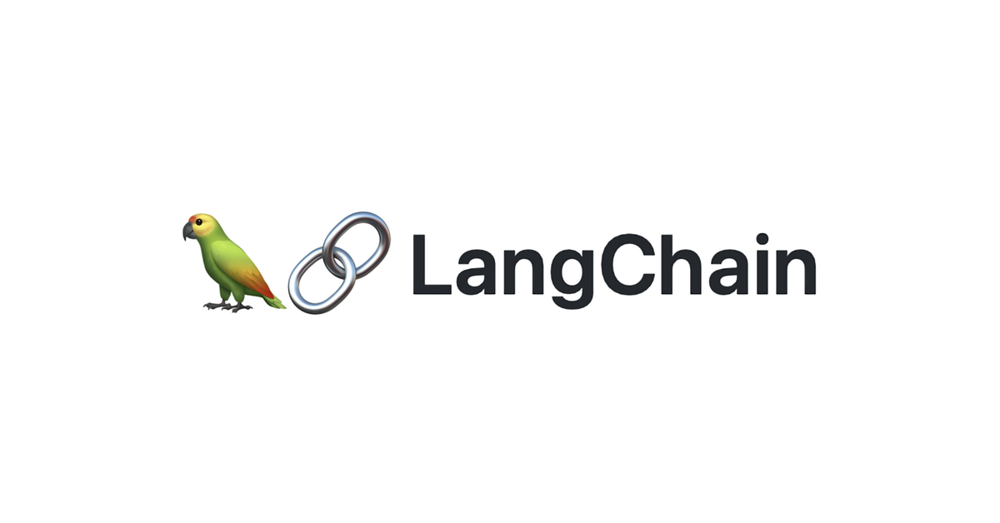
RAG from scratch: Query Translation
(Decomposition)
Lance Martin
Software Engineer, LangChain
@RLanceMartin
Notes:
Query decomposition is a popular strategy to improve retrieval that builds on chain-of-thought reasoning. Many approaches focus on decomposing a question into sub-questions, each of which is independently answered. These independent solutions are consolidated into a final answer.
Slides:
https://docs.google.com/presentation/d/1O97KYrsmYEmhpQ6nkvOVAqQYMJvIaZulGFGmz4cuuVE/edit?usp=sharing
Code:
https://github.com/langchain-ai/rag-from-scratch/blob/main/rag_from_scratch_5_to_9.ipynb
Reference:
https://arxiv.org/abs/2205.10625

Slide 2
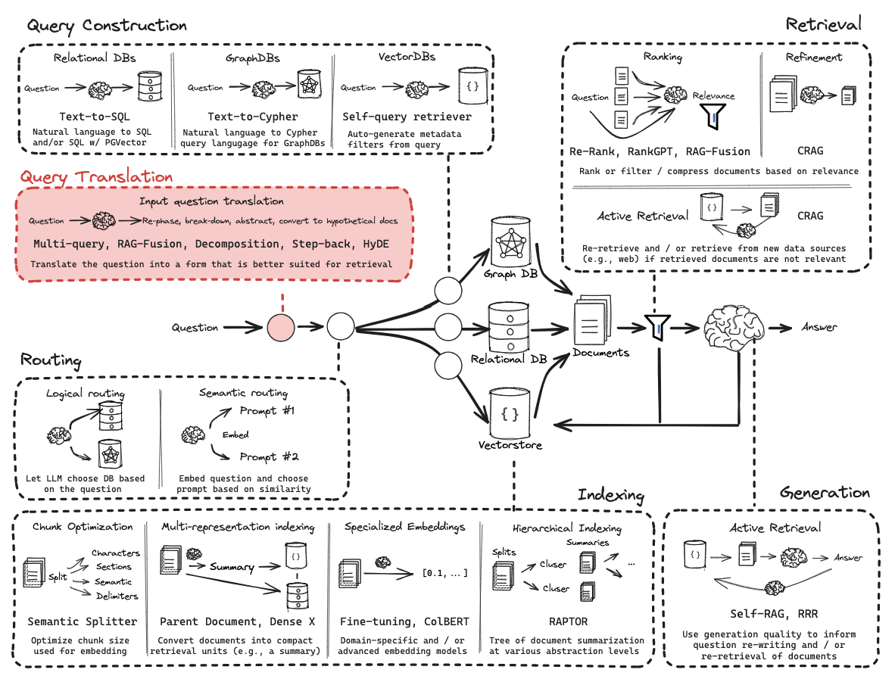
Query Translation

Slide 3
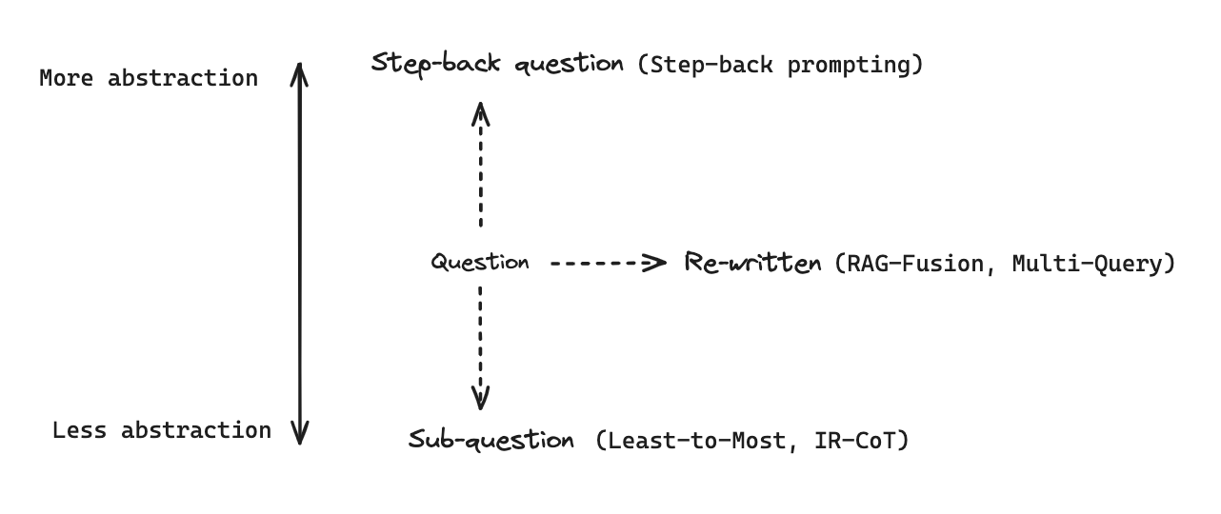
General approaches to transform questions
https://arxiv.org/pdf/2205.10625.pdf

Slide 4
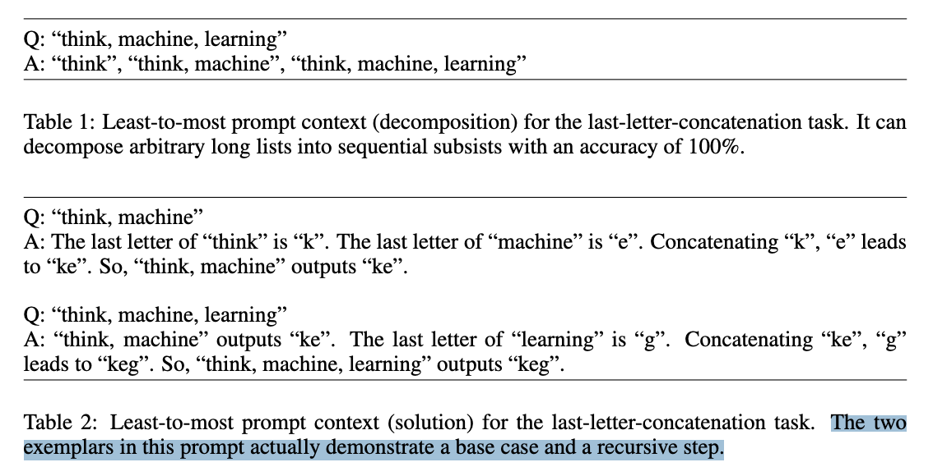
Least-to-most: Decompose problem into sub-problems, solve sequentially
(1) Decompose the problem
(2) Solve each step
using prior sub-solutions
https://arxiv.org/pdf/2205.10625.pdf

Slide 5
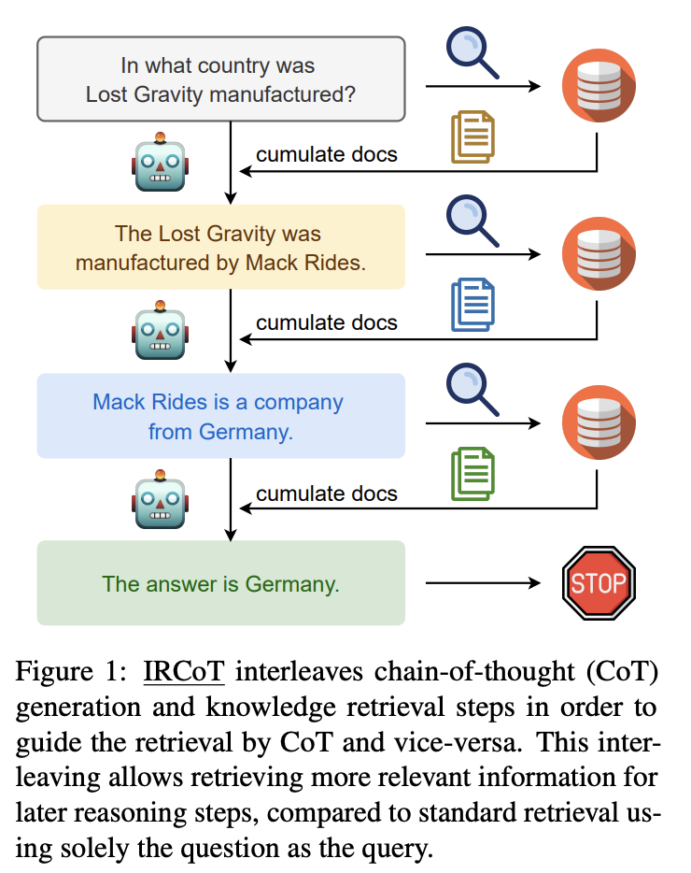
IR-CoT: Interleave retrieval with CoT
https://arxiv.org/pdf/2212.10509.pdf
Notes:
Dynamically alternates between generating CoT reasoning steps and using those steps to guide the retrieval of new information

Slide 6
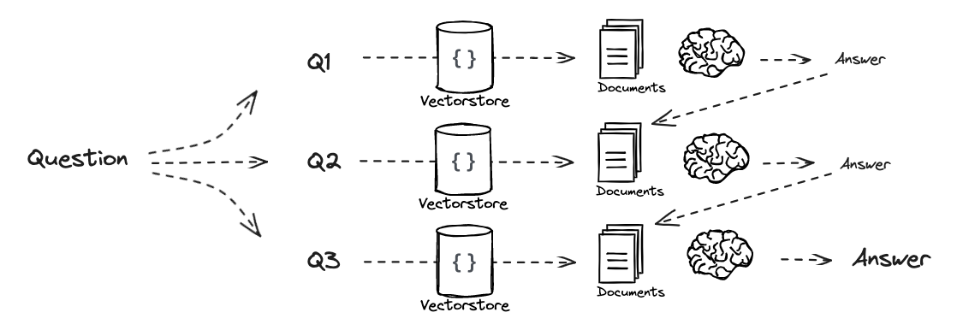
Combine ideas: Dynamically retrieve to aid in solving the subproblems

Slide 7
Code walk-through

